Slide 1

Non Functional Aspects of Web
Aruna S
Department of
Computer Science and Engineering

Slide 2

Non functional aspects of web
Multiple Requests, The HTTP 1.1 Two Connection Limit
S. Aruna
Department of Computer Science and Engineering

Slide 3
Non Functional Aspects of Web
HTTP 1.1
Browsers limit the number of HTTP connections with the same domain name. This restriction is defined in the HTTP specification (RFC2616).
Most modern browsers allow six connections per domain. Most older browsers allow only two connections per domain.
The HTTP 1.1 protocol states that single-user clients should not maintain more than two connections with any server or proxy. This is the reason for browser limits.

Slide 4
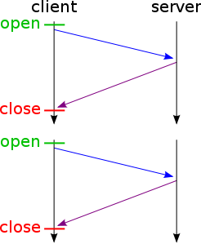
Non Functional Aspects of Web
Single Socket connection
On a single socket, a single request is sent out, and then a single response is retrieved.
A browser or other HTTP client could create multiple sockets to a server and make multiple requests.

Slide 5
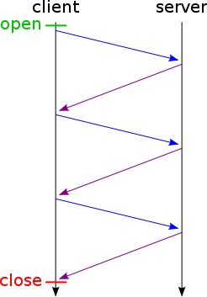
Non Functional Aspects of Web
Persistent connection
Several requests to a single server are very typical. For example an HTML file can have several referenced images. To avoid creating several connections, HTTP 1.1 introduced persistent connections.

Slide 6
Non Functional Aspects of Web
Persistent connection
Several requests to a single server are very typical. For example an HTML file can have several referenced images. To avoid creating several connections, HTTP 1.1 introduced persistent connections.

Slide 7
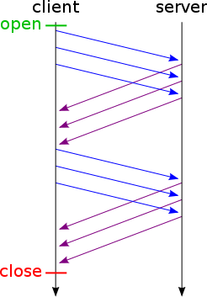
Non Functional Aspects of Web
HTTP Pipelining
HTTP pipelining is a technique in which multiple HTTP requests are sent on a single TCP(transmission control protocol) connection without waiting for the corresponding responses.
HTTPS pipelining is also possible with secure
HTTP connections and it gives an even greater degree
of speed because of the extra needed SSL/TLS handshakes.

Slide 8
Non Functional Aspects of Web
HTTP Pipelining – Browser support
Google Chrome: No
Safari: No
Internet Explorer: No
Opera: Yes
Firefox: Yes, but you need to enable it by following the below steps.
You can adjust HTTP pipelining settings in Firefox by changing the following settings in about:config.
For HTTP pipelining: Set network.http.pipelining to true
For HTTP proxy pipelining: (Use this if you want to try pipelining and you use a proxy server) Set network.http.proxy.pipelining to true
The pipelining picture in the previous slide would have a value of 3 here.

Slide 9
THANK YOU
Aruna S
Department of
Computer Science and Engineering
arunas@pes.edu

